Slide 1
Computing Basics for Bioinformatics on the Cloud
Notes:
Unix/Cloud Basics/IGV installation

Slide 2
Overview
Introduction to cloud computing
Get on to the cloud
Get around on the cloud with linux
Free bioinformatics resources on the cloud

Slide 3
What is Cloud Computing?
Cloud Computing is a general term used to describe a network based computing that takes place over the Internet
Notes:
In other words, this is a collection/group of integrated and networked hardware, software and Internet infrastructure (called a platform).
Using the Internet for communication and transport provides hardware, software and networking services to clients.
These platforms hide the complexity and details of the underlying infrastructure from users and applications by providing very simple graphical interface or API (Applications Programming Interface).

Slide 4
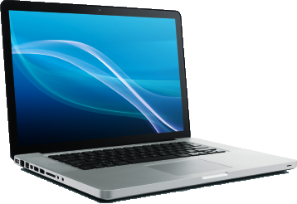
Cloud Computing Schema

Slide 5
Basic Cloud Characteristics
The “no-need-to-know” in terms of the underlying details of infrastructure, applications interface with the infrastructure via the APIs.
The “flexibility and elasticity” allows these systems to scale up and down at will – utilising the resources of all kinds (CPU, storage, server capacity, load balancing, and databases).
The “pay as much as used and needed” type of utility computing and the “always on!, anywhere and any place” type of network-based computing.

Slide 6
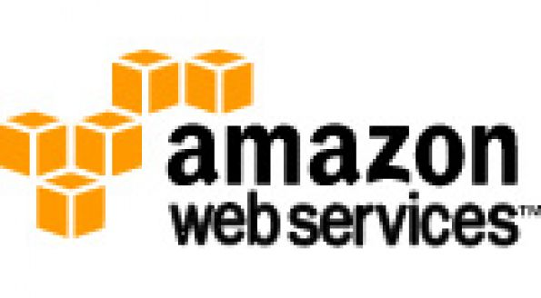


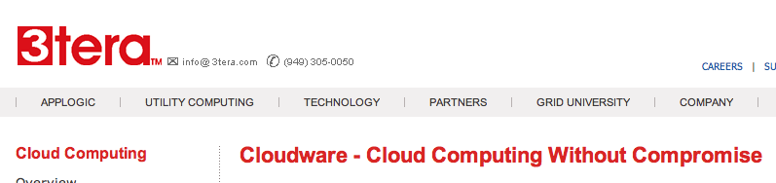






Some Commercial Cloud Offerings
Notes:
Problem: Commercial offerings are proprietary and usually not open for cloud systems research and development

Slide 7
Amazon Web Services
Elastic Compute Cloud (EC2)
Rent computing resources by the hour
Basic unit of accounting = instance-hour
Additional costs for bandwidth
Simple Storage Service (S3)
Persistent storage
Charge by the GB/month
Additional costs for bandwidth

Slide 8
Cloud Computing
Quick-start an Amazon EC2 instance

Slide 9
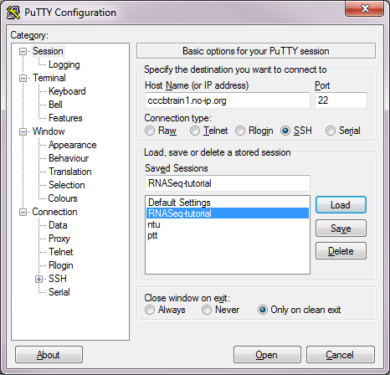
Cloud Computing: Logging in
For Windows
Download PuTTY at: http://www.chiark.greenend.org.uk/~sgtatham/putty/download.html
cccbtrain1.no-ip.org
22
Save Session
Launch!

Slide 10
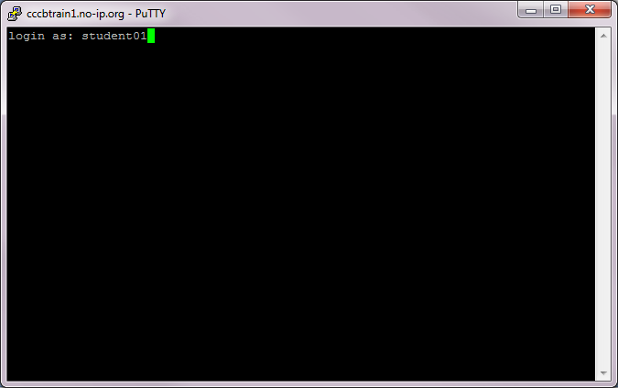
Cloud Computing: Logging in
Now you are on THE Cloud…
UID: student01

Slide 11
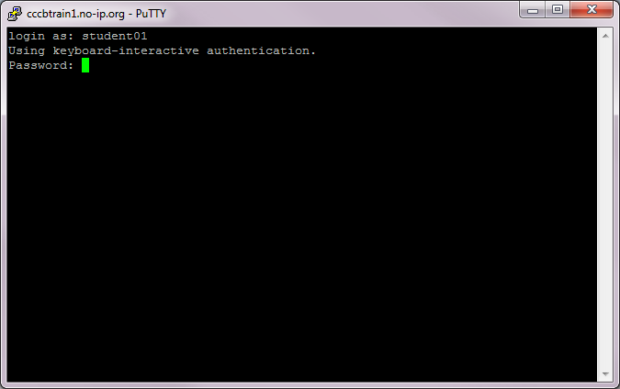
Cloud Computing: Logging in
Now you are on THE Cloud…
UID: student01
Pwd: Foo123qaz

Slide 12
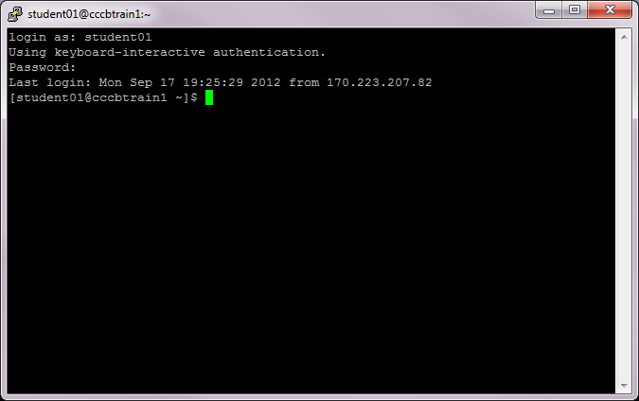
Cloud Computing: Logging in
Now you are on THE Cloud…
The “prompt”
The current directory (“path”)
The host
The User

Slide 13
Cloud Computing
How to navigate around the Cloud?
(a.k.a Linux Basics )

Slide 14
File System Organization
/
/apps
/bin
/students
/home
/etc
student01
bowtie-0.12.8
student02
bwa-0.6.2
student03
chr17_reference
student04
cufflinks-2.0.2
student25

Slide 16
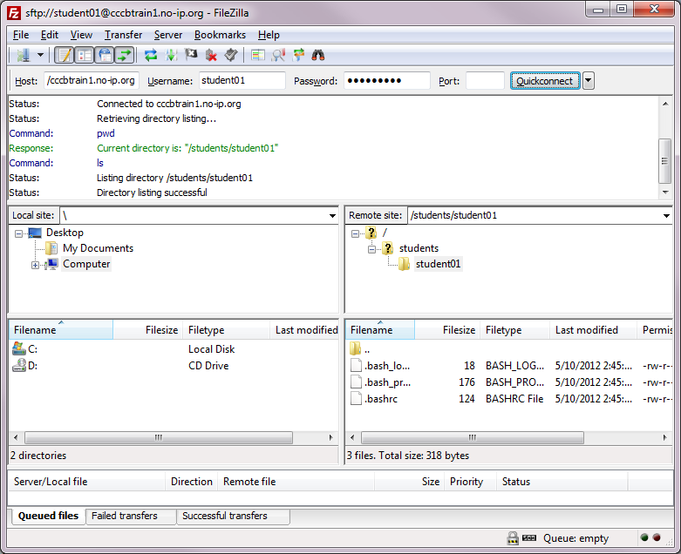

Slide 17
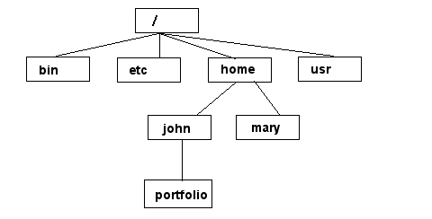
File System
NOTE: Unix file names
are CASE SENSITIVE!
/home/mary/
/home/john/portfolio/
The Path

Slide 18
Connecting to a Unix/Linux system
Open up a terminal:

Slide 19
Connecting to a Unix/Linux system
Open up a terminal:
The “prompt”
The current directory (“path”)
The host

Slide 20
What exactly is a “shell”?
After logging in, Linux/Unix starts another program called the shell
The shell interprets commands the user types and manages their execution
The shell communicates with the internal part of the operating system called the kernel
The most popular shells are: tcsh, csh, korn, and bash
The differences are most times subtle
For this tutorial, we are using bash
Shell commands are CASE SENSITIVE!

Slide 21
Help!
Whenever you need help with a command type “man” and the command name

Slide 22
Help!

Slide 23
Help!

Slide 24
Help!

Slide 25
Cloud Summary
Cloud computing is an umbrella term used to refer to Internet based development and services.
A number of characteristics define cloud data, applications services and infrastructure:
Remotely hosted: Services or data are hosted on remote infrastructure.
Ubiquitous: Services or data are available from anywhere.
Commodified: The result is a utility computing model similar to traditional that of traditional utilities, like gas and electricity - you pay for what you would want!

Slide 26
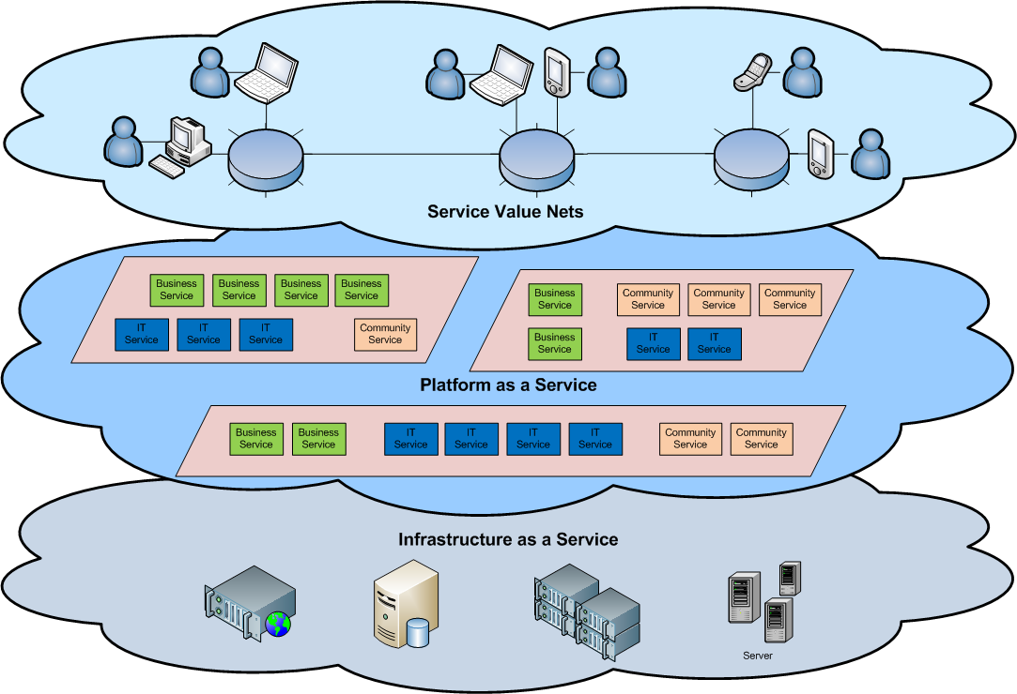
Cloud Architecture

Slide 27
Basic Cloud Characteristics
Cloud are transparent to users and applications, they can be built in multiple ways - branded products, proprietary open source, hardware or software, or just off-the-shelf PCs.
In general, they are built on clusters of PC servers and off-the-shelf components plus Open Source software combined with in-house applications and/or system software.

Slide 28
Virtualization
Virtual workspaces:
An abstraction of an execution environment that can be made dynamically available to authorised clients by using well-defined protocols,
Resource quota (e.g. CPU, memory share),
Software configuration (e.g. O/S, provided services).
Implement on Virtual Machines (VMs):
Abstraction of a physical host machine,
Hypervisor intercepts and emulates instructions from VMs, and allows management of VMs,
VMWare, Xen, etc.
Provide infrastructure API:
Plug-ins to hardware/support structures
App
App
App
OS
OS
OS
Hypervisor
Hardware
Virtualized Stack

Slide 29
Virtual Machines
VM technology allows multiple virtual machines to run on a single physical machine.
App
App
App
App
App
Xen
Guest OS
(Linux)
Guest OS
(NetBSD)
Guest OS
(Windows)
VMWare
VM
VM
VM
Virtual Machine Monitor (VMM) / Hypervisor
UML
Denali
Hardware
etc.
Performance: Para-virtualization (e.g. Xen) is very close to raw physical performance!

Slide 30
Virtualization in General
Advantages of virtual machines:
Run operating systems where the physical hardware is unavailable,
Easier to create new machines, backup machines, etc.,
Software testing using “clean” installs of operating systems and software,
Emulate more machines than are physically available,
Timeshare lightly loaded systems on one host,
Debug problems (suspend and resume the problem machine),
Easy migration of virtual machines (shutdown needed or not).
Run legacy systems!

Slide 31
What is the purpose and benefits?
Cloud computing enables companies and applications, which are system infrastructure dependent, to be infrastructure-less.
By using the Cloud infrastructure on “pay as used and on demand”, all of us can save in capital and operational investment!
Clients can:
Put their data on the platform instead of on their own desktop PCs and/or on their own servers.
They can put their applications on the cloud and use the servers within the cloud to do processing and data manipulations etc.

Slide 32
What is the purpose and benefits?
The term cloud is used to describe and to reflect this class of Internet centric computing infrastructure being transparent (users do not need to know what is behind the scenes!), highly scalable (scale up and down as needed), on-demand, pay as needed and as used.
After so many years, Cloud Computing is today the a network based computing over Internet.

